Slide 1

DiscountMart
Sales Analysis

Slide 2
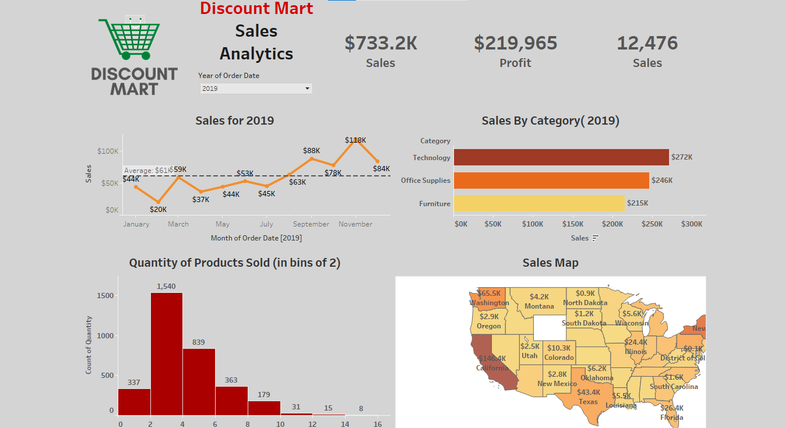
DiscountMart Dashboard with Tableau

Slide 3
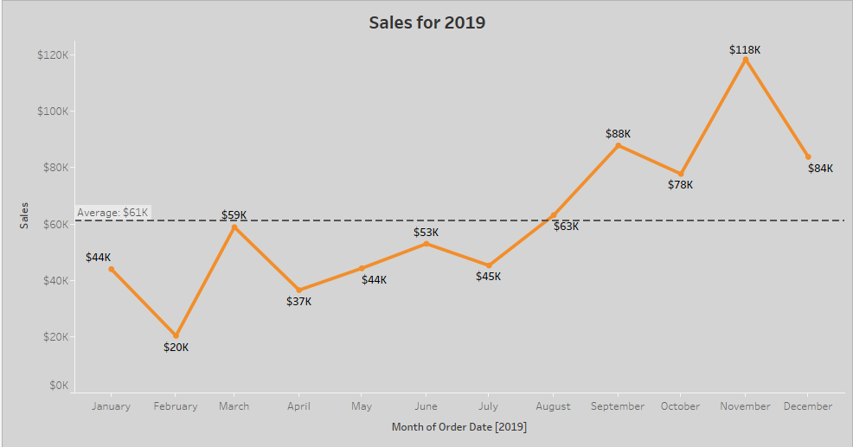
Line Chart presenting monthly sales for 2019.
DiscountMart 2019 sales peaked in November at $118k, with steady growth above the $61k
average in the last quarter.

Slide 4
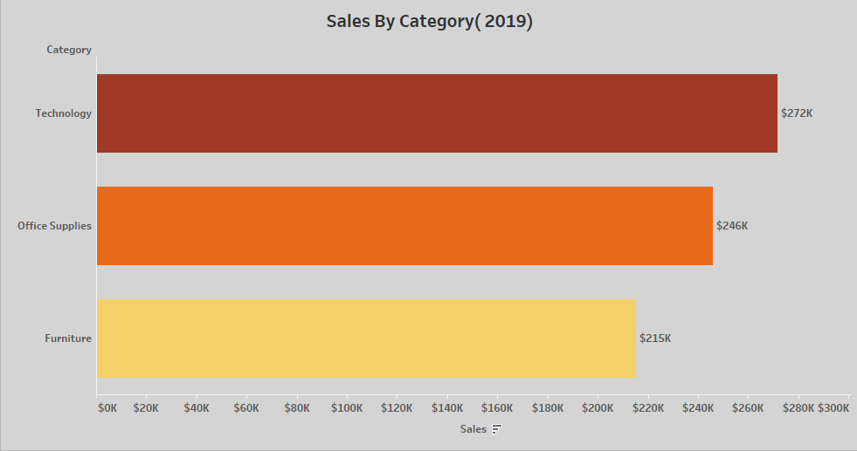
Bar Chart representing sales by Category.
Technology drove the highest sales in 2019, but Office Supplies and Furniture together
contributed nearly half of revenue.

Slide 5
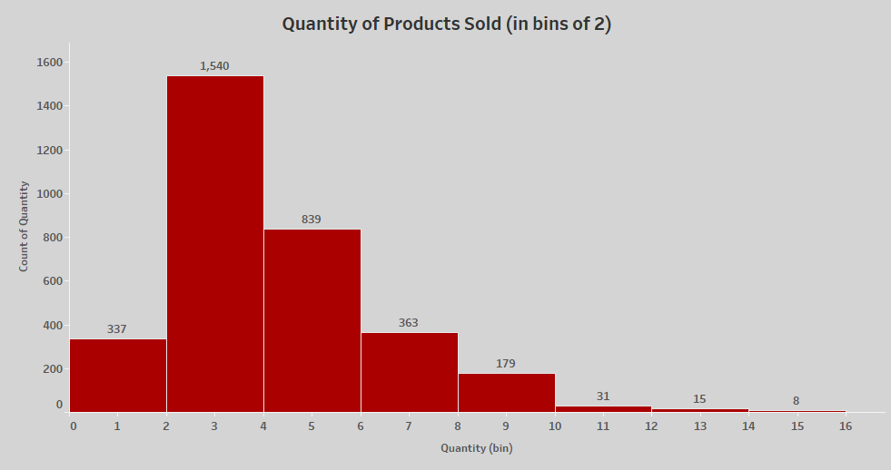
Bar Chart for Quantity of Products sold shows Low-quantity purchases (2-5 units) made up
the bulk of DiscountMart’s 2019 sales, while higher-volume orders declined sharply beyond 7 units.

Slide 6
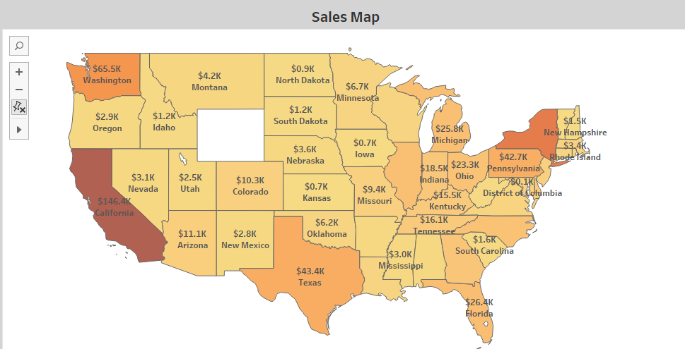
In Sales Map :
West-coast dominance led by California($146k),with notable contributions from Pennsylvania,
New York and Florida.

